Slide 1
ENSE 400 Bi-Weekly Scrum Report-Out
URStreamSight
Avery Cameron, Raymond Knorr, Noah Rowbotham
October 5, 2020

Slide 2
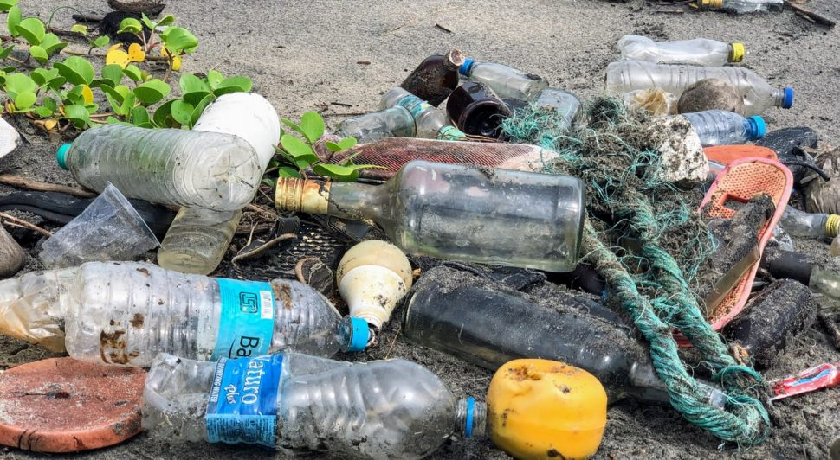
Project Details
Problem:
Citizens across Canada are confused regarding what proper recycling is.
Gap we are filling:
Giving data to municipalities to allow them to track/correct problem at its source
Innovation we are introducing:
Tool within waste trucks that scores recycling on an individual bin basis and keeps track of the data.
Notes:
Problem:
Citizens across Canada are confused regarding what proper recycling is. This leads to millions of dollars lost into processing fees and lost revenues. Poor recycling is also simply not as ecological.
Gap we are filling:
We are trying to provide municipalities a means of tracking individual households/neighborhoods for recycling quality in order to give contextual feedback to people at the source of the problem. Many people simply don’t recognize what good recycling is, and would do better given sufficient knowledge, especially if there was a monetary incentive.
Innovation we are introducing:
We want to develop a tool that operates within waste collection vehicles that could classify recyclables and non-recyclables on a bin by bin bases. This will measure the ratio of non-recyclables to recyclables in the waste and give the bin a score to be tracked by municipalities

Slide 3
Project & Documentation Review
What are you currently working on?
Documentation
Milestones (Planning and First Steps)
API Design Ideation
“Show me what you got”
Project initiating and planning
Business case and Charter
requirements
scheduling
team
Stakeholders and communications
Assumptions and risk
Quality and constraints
GitHub/Version control “stamp of approval”
Is it readable, usable, does your team confirm its “goodness”?
Notes:
Project Initiating and planning:
What are we currently working on:
We are currently working on documentation to make sure we have a strong understanding of the requirements, our project goals and timelines for deadlines and milestones. For our milestones we are planning our first steps and will expand on these as design ideas are explored. And we also worked on API Design Ideation.
Business case and Charter: completed
We intend to produce a software/hardware product that will monitor the quality of municipal recycling and give meaningful feedback to the individual households. This will help to lower the contamination in the recycling stream.
Prairie Robotics and Sam are our Sponsor and the manager of the project. The faculty and supervisors are additional stakeholders in the project.
Requirements: completed
Capture Image Data
Remove Low Quality Images
Send images to remote storage
Classify Images
Score Recyclables vs non-recyclables
Provide data to consumers
Scope: Not completed
start can be seen with our requirements and milestones
capture and store images
classify recyclables
Calculate amount of recycling per bin
Scheduling: completed
We have created a detailed outline for tasks for the first half of the year.
We have created rough outlines for tasks for the rest of the year.
Team: completed
Stick to our initial definition of roles
Avery: Machine Learning Lead
Ray: UI/API Lead
Noah: Project Manager/Flexible developer
All help out as needed to meet deadlines
Budget:
Our budget is provided by Prairie Robotics. The costs will be low and consist of AWS Computing time costs, AWS storage fees, AWS machine learning environments, and hardware totalling approximately $1000
AWS credits?
Stakeholders and communication: Completed
Weekly group check-in every Tuesday 2:30-4 to discuss issues, schedule work and work on tasks
Prairie Robotics:
Weekly/bi-weekly meetings to demonstrate work and project progress
Scrum:
Twice Monthly
Time with Dr. Maciag to demonstrate current completed work, upcoming plans and feedback
Mentor Check-in:
Approximately monthly
Time to check with mentors to discuss current work, research and receive feedback that could improve future progress.
Assumption and risks: Completed
Risks:
Limited Dataset
Poor Model Quality
Poor Image Quality
Unreliable connection with onboard computers
We completed the risk assessment, will work on risk mitigation.
Quality and constraints: Not Completed
Talked about a little in the Project Requirements document and will be finished up later.
Picturing (software) architecture: Not Completed
Will be available once documentation is finished. Possible architecture in development as options are evaluated.

Slide 4
Group reflection
Do you feel you are on track?
Overall we feel we are on track, we are excited to lay out some more of the requirements and scheduling. This first bit has given us a good intro and base for future work.
Do you feel there are barriers to your success (if any)?
The quality of image data in the future could be a barrier, we have some ideas for datasets and collections but that is part of future work and the 496AC project.
Do you need any help going forward?
Currently we seem to be alright but talking with Dr. Yow about machine learning would be helpful later on. Documentation questions might come up later on and require help.
Any other questions or concerns?
Are we doing alright for our GitHub setup for our project so far?
How do we do the RACI chart?
Notes:
RACI stands for Responsible Accountable Consulted Informed, Noah had some questions.

Slide 5
Image Refs
https://cleanriver.com/how-to-reduce-recycling-contamination/

